Slide 1


CoB191: Business Analytics I
Chapter 8
Modified and adapted by Ehsan Teymourian
Notes:
Add slide notes here

Slide 2
Chapter 8 Interval Estimation
Case I: Population Mean with σ Known
Case II: Population Mean with σ Unknown
Case III: Population Proportion

Slide 3
Target Parameter
The unknown population parameter (e.g., mean or proportion) that we are interested in estimating is called the target parameter.
Parameter Key Words of Phrase Type of Data
µ mean; average quantitative
p proportion; percentage qualitative
fraction; rate

Slide 4
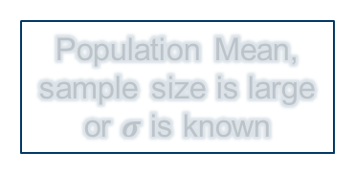
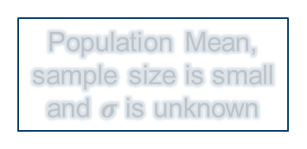
Estimation Methods
Estimation
Point Estimation
Interval Estimation
Population Mean, sample size is large or $σ$ is known
Population Mean, sample size is small and $σ$ is unknown
Population Proportion sample size is large
Notes:
14

Slide 5
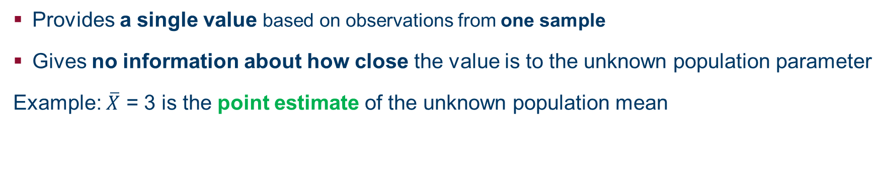
Point Estimator
A point estimator of a population parameter is a rule or formula that tells us how to use the sample data to calculate a single number that can be used as an estimate of the target parameter.
Provides a single value based on observations from one sample
Gives no information about how close the value is to the unknown population parameter
Example: $\overline{X}$ = 3 is the point estimate of the unknown population mean

Slide 6
Estimation Methods
Estimation
Point Estimation
Interval Estimation
Population Mean, sample size is large or $σ$ is known
Population Mean, sample size is small and $σ$ is unknown
Population Proportion sample size is large
Notes:
14

Slide 7
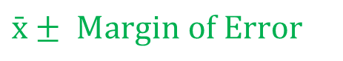
Margin of Error and the Interval Estimate
A point estimator cannot be expected to provide the exact value of the population parameter.
An interval estimate can be computed by adding and subtracting a margin of error to the point estimate.
$$\text{Interval} \text{Estimate}\text{ = }\text{Point} \text{Estimate} ± \text{Margin} \text{of} \text{Error}$$
The purpose of an interval estimate is to provide information about how close the point estimate can be to the value of the parameter.
The general form of an interval estimate of a population mean is
$$\bar{x}± Margin of Error$$

Slide 8
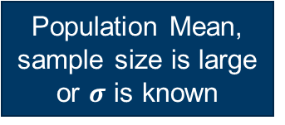
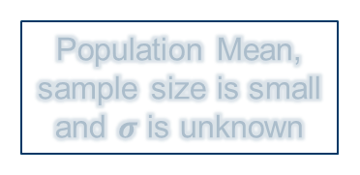
Estimation Methods
Estimation
Point Estimation
Interval Estimation
Population Mean, sample size is large or $σ$ is known
Population Mean, sample size is small and $σ$ is unknown
Population Proportion sample size is large
Notes:
14

Slide 9
Interval Estimate of a Population Mean: σ Known (1 of 9)
To develop an interval estimate of a population mean, the margin of error must be computed using either:
the population standard deviation σ, or
the sample standard deviation s
σ is rarely known exactly, but often a good estimate can be obtained based on historical data or other information.
We refer to such cases as the σ known case (Case I).

Slide 10
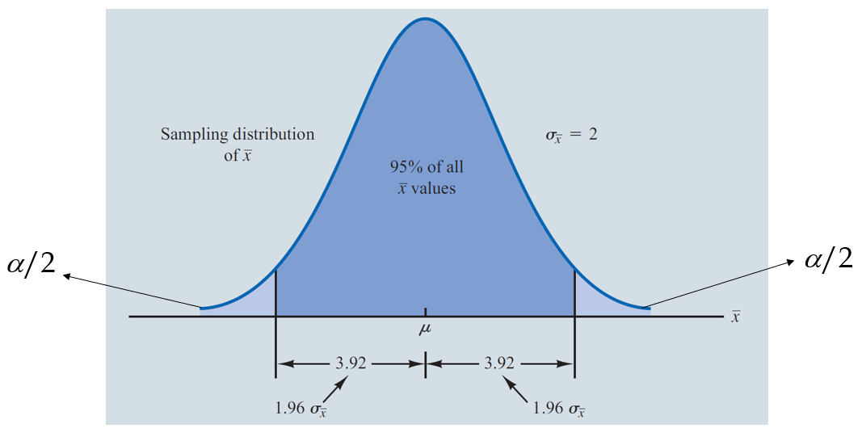
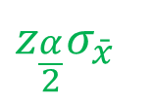
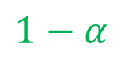
Interval Estimate of a Population Mean: σ Known (2 of 9)
There is a
probability that the value of a sample mean will provide a margin of error of
$$1−α$$
or less, i.e., percent of the estimates (using sample means) are at most from the population mean (what we are estimating).
$$z_{\frac{α}{2}}σ_{\bar{x}}$$

Slide 11
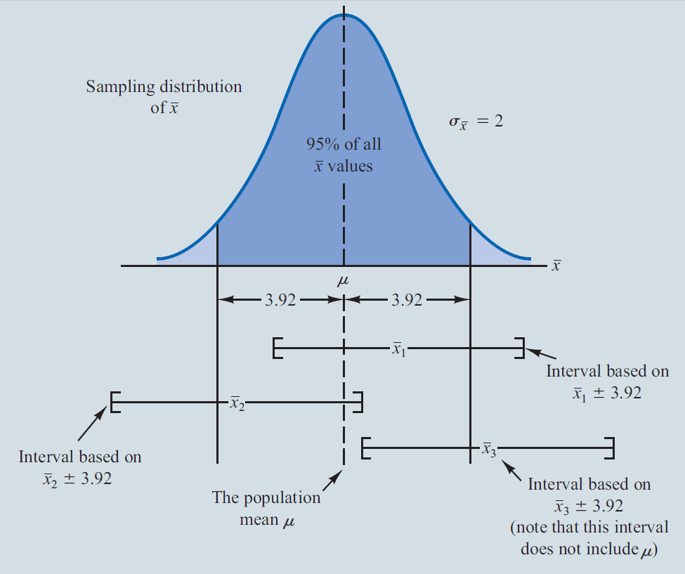
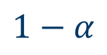
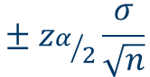
Interval Estimate of a Population Mean: σ Known (3 of 9)
Similarly, percent of the sample means can correctly estimate the population mean.
$$1−α$$
$$± z_{α/2}\frac{σ}{\sqrt{n}}$$

Slide 12
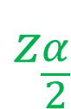

Interval Estimate of a Population Mean: σ Known (4 of 9)
Interval Estimate of µ
Note: $z_{α/2}$ = NORM.S.INV(1-($α$/2))
where:
is the sample mean
is the confidence coefficient
$$z_{\frac{α}{2}}$$
is the z value providing an area of α/2 in the upper tail of the standard normal probability distribution
σ is the population standard deviation
n is the sample size

Slide 13
Values of for the Most Commonly Used Confidence Levels
Confidence level | α | α/2 | z_{α/2}
90% | .1 | .05 | NORM.S.INV(0.95)= 1.645
95% | .05 | .025 | NORM.S.INV(0.975)= 1.960
99% | .01 | .005 | NORM.S.INV(0.995)= 2.576

Slide 14
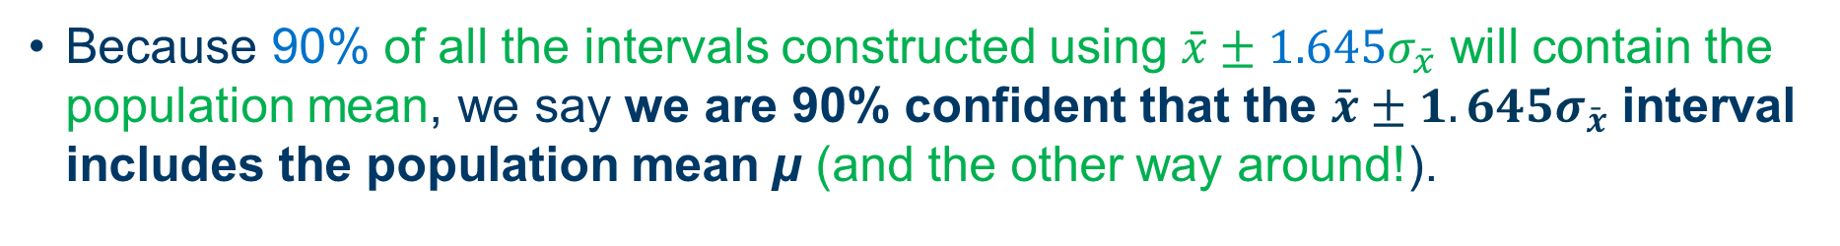
Meaning of Confidence
Interval Estimate of a Population Mean: σ Known (5 of 9)
We say that this interval has been established at the 90% confidence level.
The value .90 is referred to as the confidence coefficient.
Because 90% of all the intervals constructed using $\bar{x}±1.645σ_{\bar{x}}$ will contain the population mean, we say we are 90% confident that the $\bar{x}±1.645σ_{\bar{x}}$ interval includes the population mean µ (and the other way around!).

Slide 15
Interval Estimate of a Population Mean: σ Known (6 of 9)
Example: Lloyds Department store
Each week Lloyds department store selects a simple random sample of 100 customers in order to learn about the amount spent per shopping trip. The historical data indicates that the population follows a normal distribution.
During most recent week, Lloyd’s surveyed 100 customers (n = 100) and obtained a sample mean of
Based on historical data, Lloyd’s now assumes a known value of
The confidence coefficient to be used in the interval estimate is .95.

Slide 16
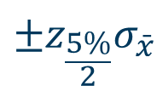
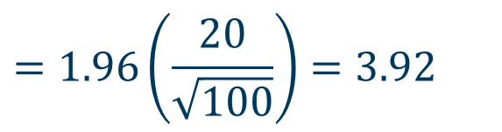
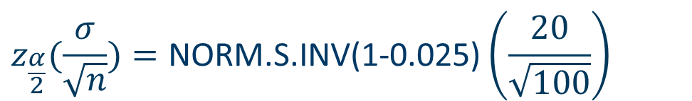
Interval Estimate of a Population Mean: σ Known (7 of 9)
Example: Lloyds Department store
95% of the sample means that can be observed are within
$$±z_{\frac{5\%}{2}}σ_{\bar{x}}$$
of the
population mean µ. The margin of error is:
$$z_{\frac{α}{2}}(\frac{σ}{\sqrt{n}})=\text{NORM}\text{.}\text{S}\text{.}\text{INV}\text{(1−0.025)}\left(\frac{20}{\sqrt{100}}\right)$$
$$=1.96\left(\frac{20}{\sqrt{100}}\right)=3.92$$

Slide 17
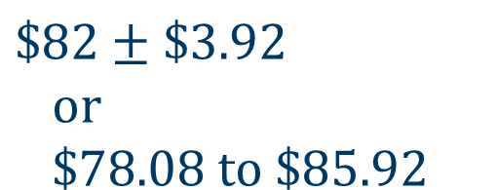
Interval Estimate of a Population Mean: σ Known (8 of 9)
Example: Lloyds Department store
Interval estimate of µ is:
$$\$82±\$3.92 \\ \text{or} \\ \$78.08 \text{to}\text{ \$85.} \text{9}\text{2}$$
We are 95% confident that the interval, (78.08, 85.92), contains the population mean µ.
95% of all the intervals constructed using $\overline{X}±3.92$ include population mean µ (and the other way around: $μ±3.92$ include 95% of all sample means $\overline{X}$).

Slide 18
Interval Estimate of a Population Mean: σ Known (9 of 9)
Example: Lloyds Department store
Confidence level | Margin of Error | Interval estimate
90% | 3.29 | (78.71 , 85.29)
95% | 3.92 | (78.08 , 85.92)
99% | 5.15 | (76.85 , 87.15)
To have a higher degree of confidence, the margin of error and thus the width of the confidence interval must be larger (i.e., less accurate)

Slide 19
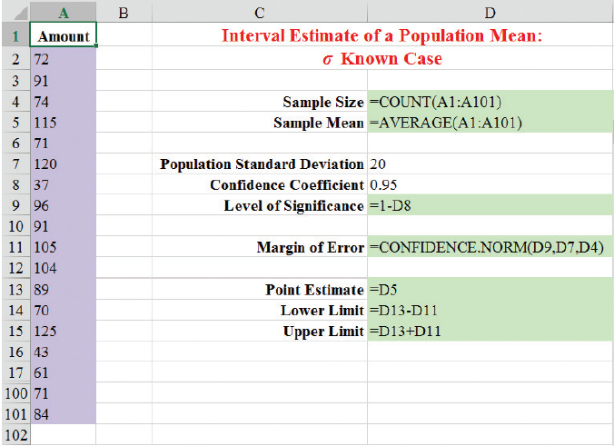
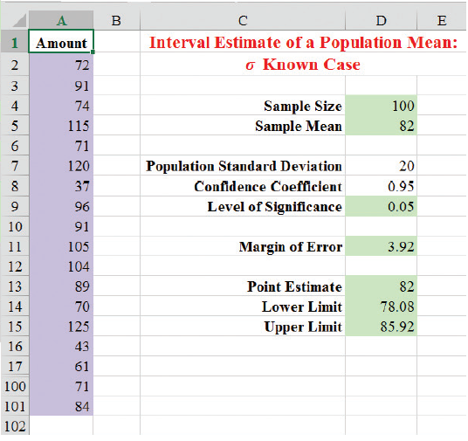
Using Excel to construct a confidence interval - σ Known
Note: Rows 18 to 99 are not shown.

Slide 20
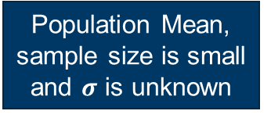
Estimation Methods
Estimation
Point Estimation
Interval Estimation
Population Mean, sample size is large or $σ$ is known
Population Mean, sample size is small and $σ$ is unknown
Population Proportion sample size is large
Notes:
14

Slide 21
Interval Estimate of a Population Mean
If an estimate of the population standard deviation σ cannot be developed prior to sampling, we use the sample standard deviation s to estimate σ.
This is the σ unknown case (Case II).
In this case, the interval estimate for µ is based on the t distribution.
(We’ll assume for now that the population is normally distributed.)

Slide 22
t Distribution (1 of 3)
The t distribution is a family of similar probability distributions.
A specific t distribution depends on a parameter known as the degrees of freedom.
Degrees of freedom refer to the number of independent pieces of information that go into the computation of s.
A t distribution with more degrees of freedom has less dispersion.
As the degrees of freedom increase, the difference between the t distribution and the standard normal probability distribution becomes smaller and smaller.
William Gosset, writing under the name “Student,” is the founder of the t distribution.

Slide 23
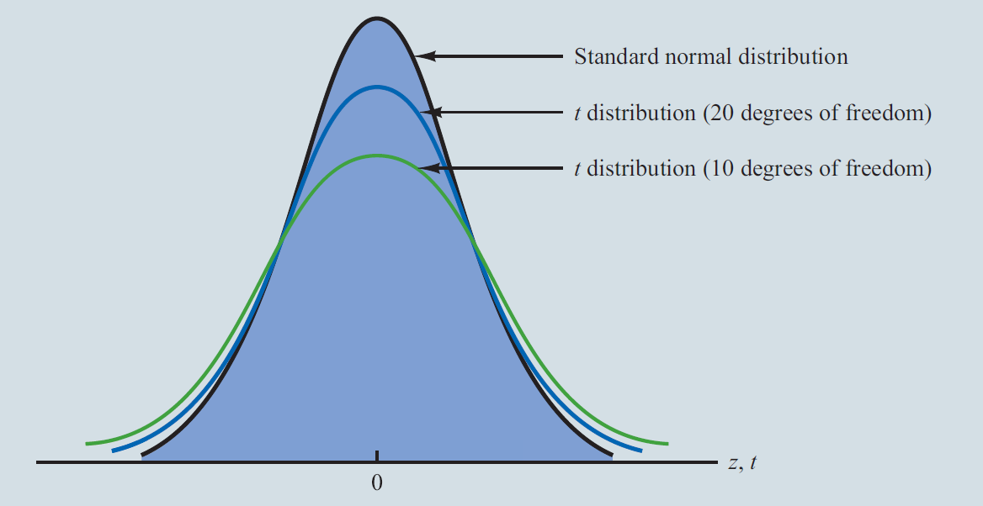
t Distribution (2 of 3)
Comparison of the standard normal distribution with t distributions having 10 and 20 degrees of freedom.

Slide 24
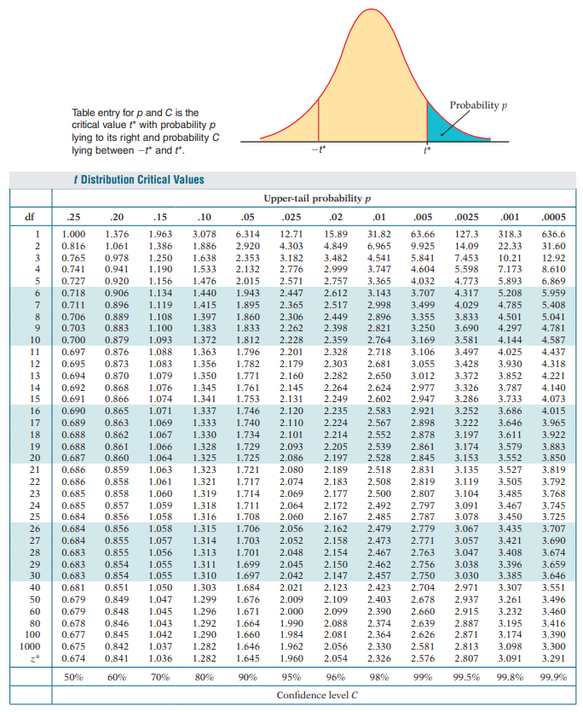
t Distribution (3 of 3)
For more than 100 degrees of freedom, the standard normal z value provides a good approximation to the t value.
The standard normal z values can be found in the infinite degrees row (labeled ∞) of the t distribution table.

Slide 25
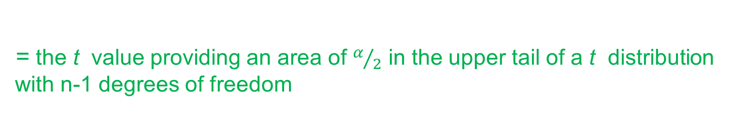
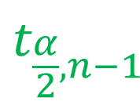
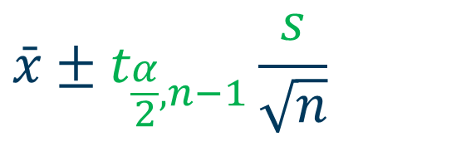

Interval Estimate of a Population Mean: σ Unknown (1 of 4)
$$\bar{x}±t_{\frac{α}{2}, n−1}\frac{s}{\sqrt{n}}$$
Note: $t_{α/2}$ = t.INV(1-($α$/2), n-1)
where:
= the sample mean
= the confidence coefficient
$$t_{\frac{α}{2}, n−1}$$
= the t value providing an area of $α/2$ in the upper tail of a t distribution with n-1 degrees of freedom
s = the sample standard deviation
n = the sample size

Slide 26
Interval Estimate of a Population Mean: σ Unknown (2 of 4)
Example: Credit card debt for the population of US households
The credit card balances of a sample of 70 households provided a mean credit card debt of $9,312 with a sample standard deviation of $4,007.
Let us provide a 95% confidence interval estimate of the mean credit card debt for the population of US households. We will assume this population to be normally distributed.

Slide 27
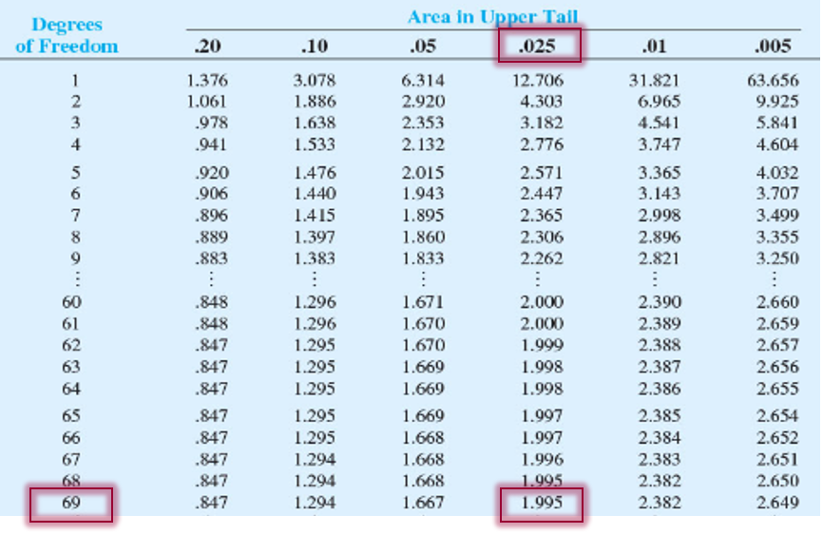
Interval Estimate of a Population Mean: σ Unknown (3 of 4)
At 95% confidence,

Slide 28
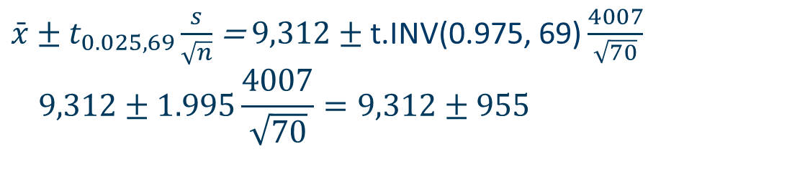
Interval Estimate of a Population Mean: σ Unknown (4 of 4)
Example: Credit card debt for the population of U.S. households
$\bar{x}±t_{0.025, 69}\frac{s}{\sqrt{n}}$ = $9,312±\text{t}\text{.}\text{INV}\text{(0.975, 69)}\frac{4007}{\sqrt{70}}$ $$9,312±1.995\frac{4007}{\sqrt{70}}=9,312±955$$
We are 95% confident that the mean credit card debt for the population of U.S. households is between $8,357 and $10,267.

Slide 29
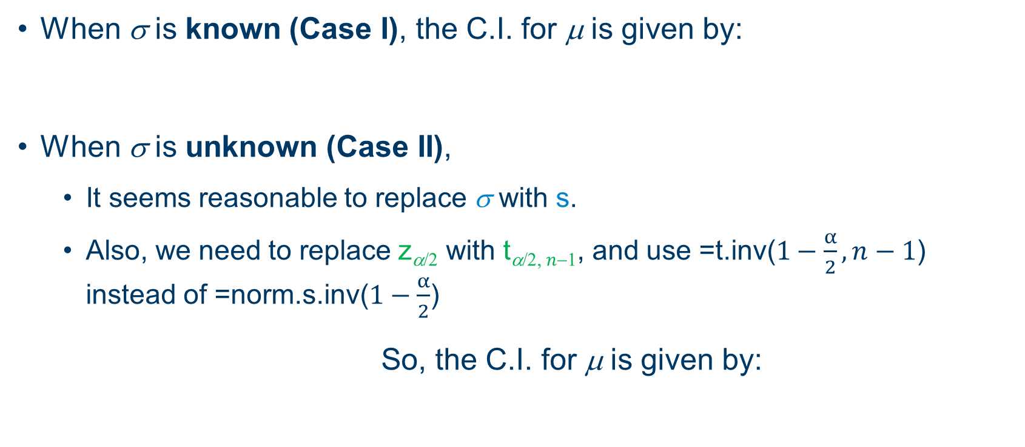
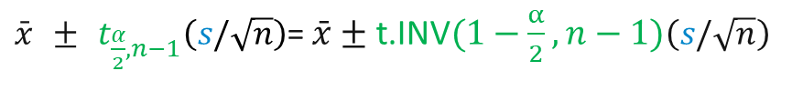
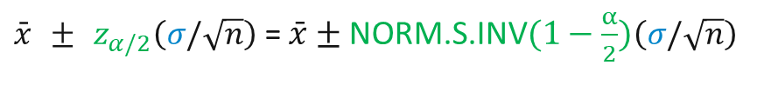
Confidence Interval for a Population Mean
When σ is known (Case I), the C.I. for μ is given by:
When σ is unknown (Case II),
It seems reasonable to replace σ with s.
Also, we need to replace z_{α/2} with t_{α/2,} $n$₋₁, and use =$\text{t}\text{.}\text{inv}\text{(}1−\frac{α}{2},n−1\text{)}$ instead of =$\text{norm}\text{.}\text{s}\text{.}\text{inv}\text{(}1−\frac{α}{2}$)
So, the C.I. for μ is given by:
$\bar{x} ± z_{α/2}\left(σ/\sqrt{n}\right)$ = $\bar{x}±\text{NORM}\text{.}\text{S}\text{.}\text{INV}(1−\frac{α}{2})\left(σ/\sqrt{n}\right)$
$\bar{x} ± t_{\frac{α}{2},n−1}\left(s/\sqrt{n}\right)$= $\bar{x}±\text{t}\text{.}\text{INV}(1−\frac{α}{2},n−1)\left(s/\sqrt{n}\right)$

Slide 30
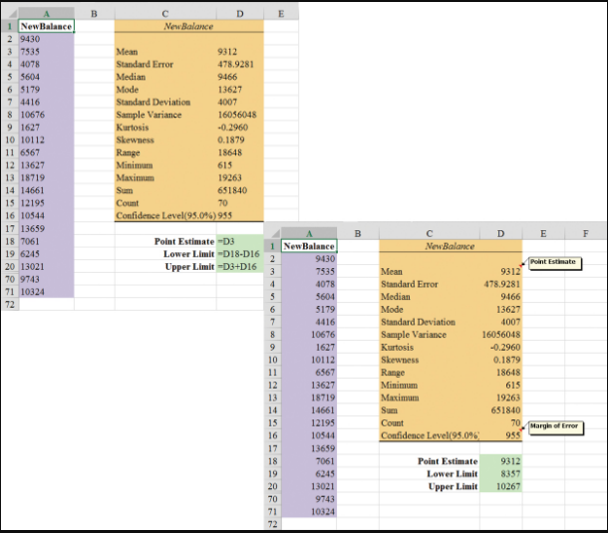
Excel’s Descriptive Statistics Tool
Excel Worksheets
95% confidence interval
for credit card balances.

Slide 31
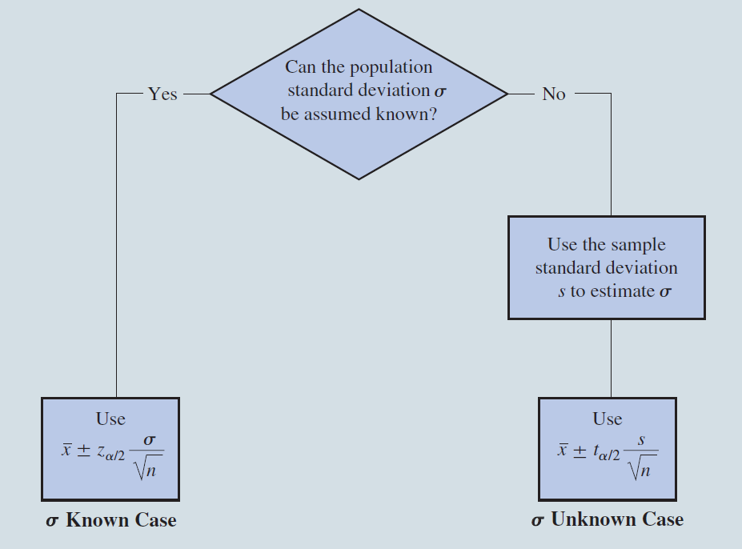
Summary of Interval Estimation Procedures for a Population Mean

Slide 32
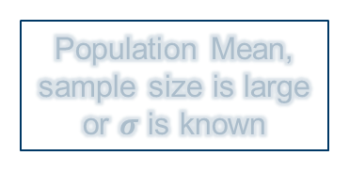
Estimation Methods
Estimation
Point Estimation
Interval Estimation
Population Mean, sample size is large or $σ$ is known
Population Mean, sample size is small and $σ$ is unknown
Population Proportion sample size is large
Notes:
14

Slide 33
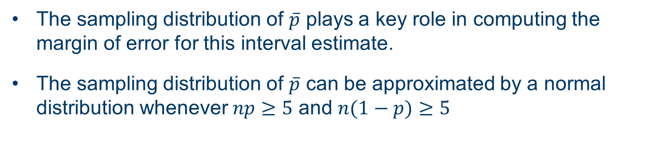
Interval Estimate of a Population Proportion (1 of 5)
The general form of an interval estimate of a population proportion is:
The sampling distribution of $\overline{p}$ plays a key role in computing the margin of error for this interval estimate.
The sampling distribution of $\overline{p}$ can be approximated by a normal distribution whenever $np≥5$ and $n(1−p)≥5$

Slide 34
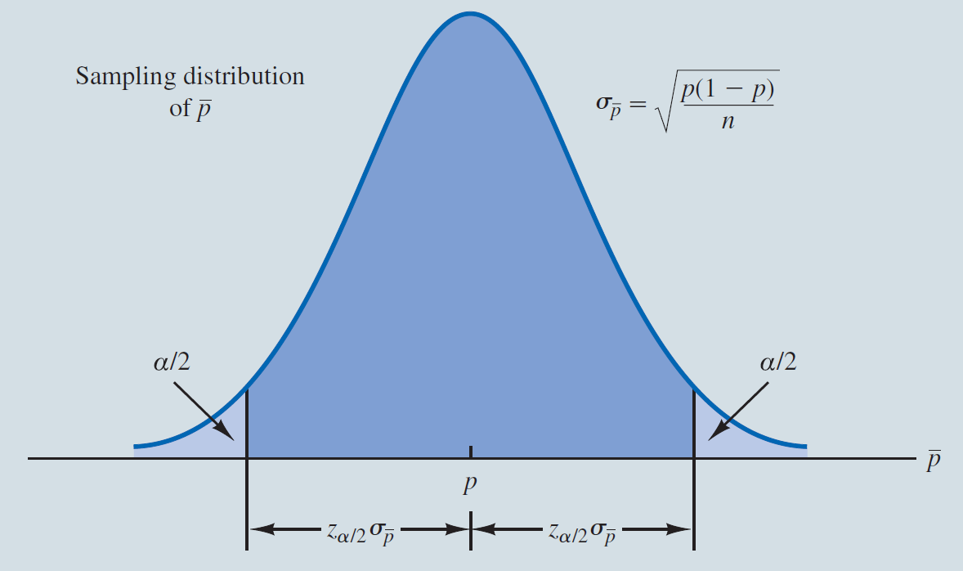
Interval Estimate of a Population Proportion (2 of 5)
Normal Approximation of Sampling Distribution of

Slide 35
Interval Estimate of a Population Proportion (3 of 5)
is the confidence coefficient,
is the z value providing an area of
in the upper tail of the
standard normal probability distribution, and
is the sample proportion

Slide 36
Interval Estimate of a Population Proportion (4 of 5)
Example: Survey of women golfers
A national survey of 900 women golfers was conducted to learn how women golfers view their treatment at golf courses in United States. The survey found that 396 of the women golfers were satisfied with the availability of tee times.
Suppose one wants to develop a 95% confidence interval estimate for the proportion of the population of women golfers satisfied with the availability of tee times.

Slide 37
Interval Estimate of a Population Proportion (5 of 5)
Example: Survey of women golfers
$$where:n=900, \bar{p}=\frac{396}{900}=.44, z_{\frac{α}{2}}=NORM.S.INV\left(0.975\right)=1.96$$
Survey results enable us to state with 95% confidence that between 40.76% and 47.24% of all women golfers are satisfied with the availability of tee times.

Slide 38
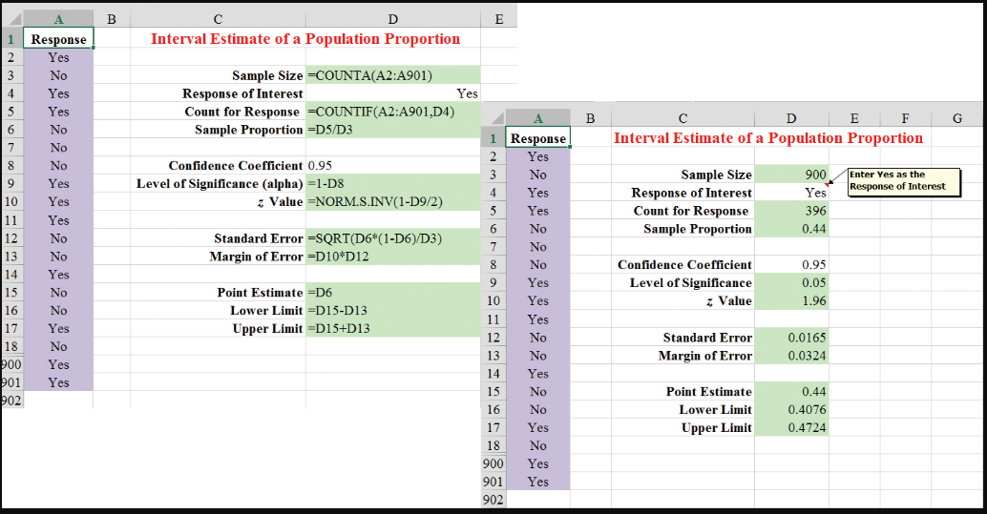
Excel to construct a confidence interval
Excel Formula and Value Worksheet

Slide 39
End of Chapter 8

